Slide 1



Slide 3
MATRIX
“Rectangular array of numbers”
ORDER
“If there are m rows and n columns in a matrix, mxn”

Slide 4
Matrix Multiplication

Slide 5
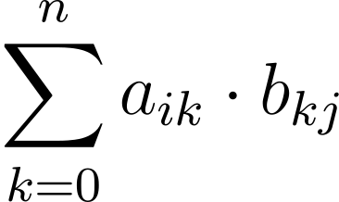
Brute Force Algorithm
import numpy as np
def matMul(A, B):
'''
Product of two square Matrices A and B using 3 for loops
'''
C = np.zeros((m, o), np.int16)
for i in range(0, m):
for j in range(0, o):
for k in range(0, n):
C[i][j] += A[i][k]*B[k][j]
return C

Slide 6

TIME COMPLEXITY OF BFA
Multiplication of two numbers turns out to be the most time consuming operation in this algorithm. So time complexity will depend on #(Multiplications) we perform.
Here we perform $n$ multiplications per value to compute $m×o$ values.
Taking case of multiplication of two $n×n$ matrices, we get total $n^{3}$multiplication operations. Thus, complexity of our method for two $n×n$ matrices can be denoted by:
$$T\left(n\right)=O(n^{3})$$
CAN WE DO ANY BETTER?

Slide 7



Strassen’s MM Algo.
Multiplication of two numbers turns out to be the most time consuming operation in this algorithm. So time complexity will depend on #(Multiplications) we perform.
Here we perform $n$ multiplications per value to compute $m×o$ values.
Taking case of multiplication of two $n×n$ matrices, we get total $n^{3}$multiplication operations. Thus, complexity of our method for two $n×n$ matrices can be denoted by:
$$T\left(n\right)=O(n^{3})$$
CAN WE DO ANY BETTER?
Strassen’s Matrix Multiplication crunches the time complexity to
$$T\left(n\right)=O(n^{\text{2.807}})$$

Slide 8
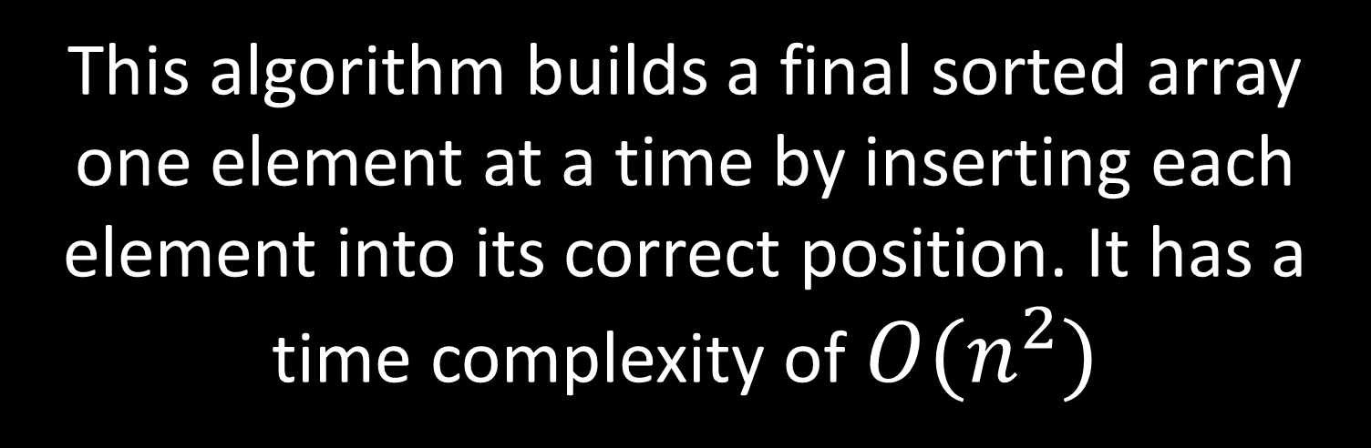
Divide and Conquer
Insertion Sort
This algorithm builds a final sorted array one element at a time by inserting each element into its correct position. It has a time complexity of $O(n^{2})$

Slide 9


Divide and Conquer
Insertion Sort
$$\#S_{worst}=\sum_{i=2}^{n}{i−1}=\frac{\left(n−1\right)\left(n−2\right)}{2}$$
$$=O(n^{2})$$

Slide 10
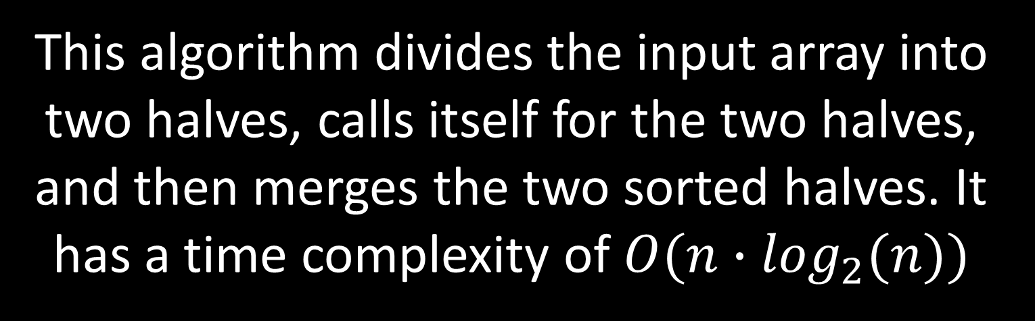
Divide and Conquer
Merge Sort
This algorithm divides the input array into two halves, calls itself for the two halves, and then merges the two sorted halves. It has a time complexity of $O(n∙\log_{2}(n))$

Slide 11


Divide and Conquer
Merge Sort
$$T\left(n\right)=2∙T\left(n/2\right)+D\left(n\right)+C(n)$$
$$=O(n∙\log_{2}(n))$$

Slide 12
Strassen’s MM Algo

Slide 13
Strassen’s MM Algo

Slide 14
Strassen’s MM Algo

Slide 15
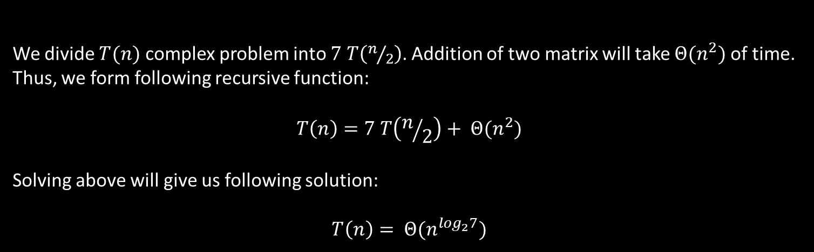
Strassen’s MM Algo
We divide $T(n)$ complex problem into $7$ $T\left(n/2\right)$. Addition of two matrix will take $Θ(n^{2})$ of time. Thus, we form following recursive function:
$$T\left(n\right)=7 T\left(n/2\right)+ Θ(n^{2})$$
Solving above will give us following solution:
$$T\left(n\right)= Θ(n^{\log_{2}7})$$

Slide 16
Let’s put it into a test

Slide 17
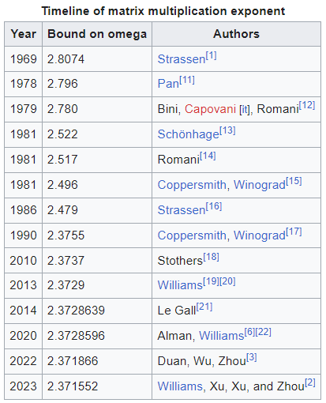
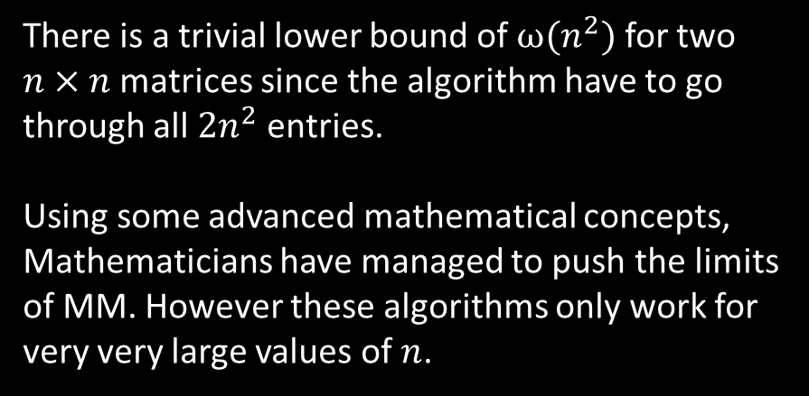
Significance of SMMA
There is a trivial lower bound of $ω(n^{2})$ for two $n×n$ matrices since the algorithm have to go through all $2n^{2}$ entries.
Using some advanced mathematical concepts,
Mathematicians have managed to push the limits of MM. However these algorithms only work for very very large values of $n$.

